Slide 1
PGPDSE FT- Project
Subject- Machine Learning
Title: Regression & Classification model
Submitted By : Gayatri Patil

Slide 2
Problem Statement:
Zomato is an Indian company that provides a platform for users to search for and discover restaurants, as well as order food for delivery. It was founded in 2008 by Deepinder Goyal and Pankaj Chaddah and has since expanded to multiple countries around the world. Zomato provides users with information about restaurants such as menus, prices, and user reviews to help them make informed decisions about where to eat. The company also partners with restaurants to offer food delivery options to customers.

Slide 3
About the Data:
Zomato is an Indian multinational restaurant aggregator and food delivery company founded by Deepinder Goyal and Pankaj Chaddah in 2008. Zomato provides information, menus, and user reviews of restaurants as well as food delivery options from partner restaurants in select cities.
Attributes:
URL - Website of the Zomato for each restaurant. - Object datatype
Address - Address of the Restaurant. - Object datatype
Name - Name of the restaurant. - Object datatype
Online Order - The customer ordered the menu online or not. - Object datatype
Book table - The customer has booked the table or not. - Object datatype
Rate - Rating of the restaurant that has by the customer. - Numerical datatype
Votes - The votes have been given by the customer to the restaurant. - Numerical datatype
Phone - Contact number of the Restaurant. - Object datatype
Location - The city name where the restaurant is located. - Object datatype
Rest Type - The type of restaurant. - Object datatype
Dish liked - Dishes liked by the customer from the restaurant. - Object datatype
Cuisines - The cuisines that have been prepared by the restaurant. - Object datatype
Approx Cost for two people - The approximate cost of the customer for 2 people. - Number datatype
Reviews list - The reviews made by the customers on the restaurant. - Object datatype
Menu Item - The menu items that are usually available at the restaurant. - Object datatype
Listed in (type) - Contains the type of the meal. - Object datatype
Listed in (city) - This contains the neighborhood in which the restaurant is listed. - Object datatype

Slide 4
Business Importance:
Zomato's platform provides significant business benefits to both customers and restaurants:
Increased visibility:
Zomato provides restaurants with increased visibility to potential customers, as it has a large user base that regularly uses the platform to search for and discover new restaurants.
Improved customer experience: Zomato provides users with a wealth of information about restaurants, including menus, prices, and user reviews. This information can help users make informed decisions about where to eat and can improve their overall dining experience.
Online ordering and delivery: Zomato's partnership with restaurants allows them to offer online ordering and delivery options, which can increase sales and revenue for the restaurant.
Marketing and promotion: Zomato offers marketing and promotional services to restaurants, such as sponsored listings and targeted advertising. This can help restaurants reach a wider audience and increase their customer base.
Data analytics: Zomato's platform provides restaurants with valuable data analytics that can help them make better business decisions. For example, they can track sales, monitor customer feedback, and identify trends in customer preferences.

Slide 5
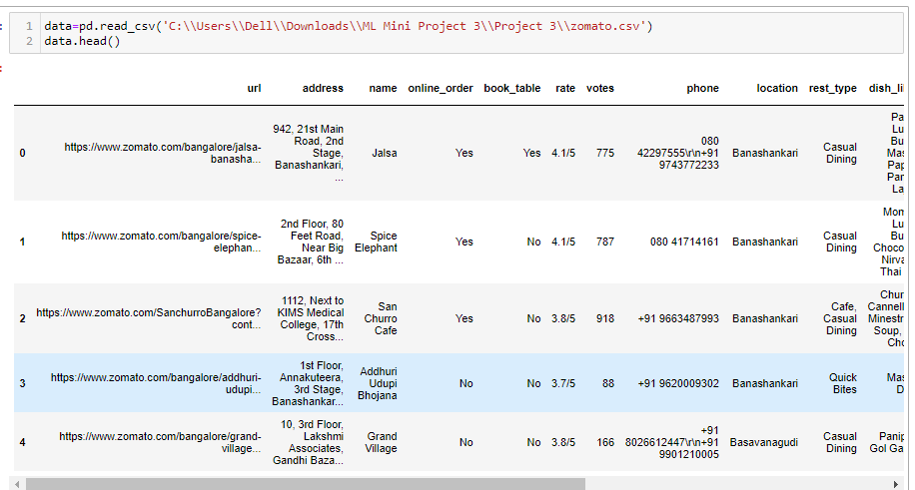
Step 1: Understand the business problem.

Slide 6
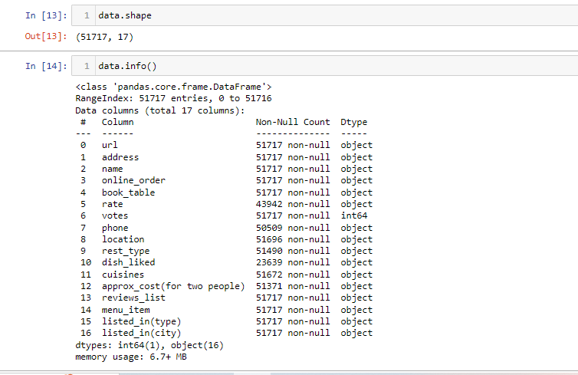
Step 2: Read the data, and convert the data types.

Slide 7
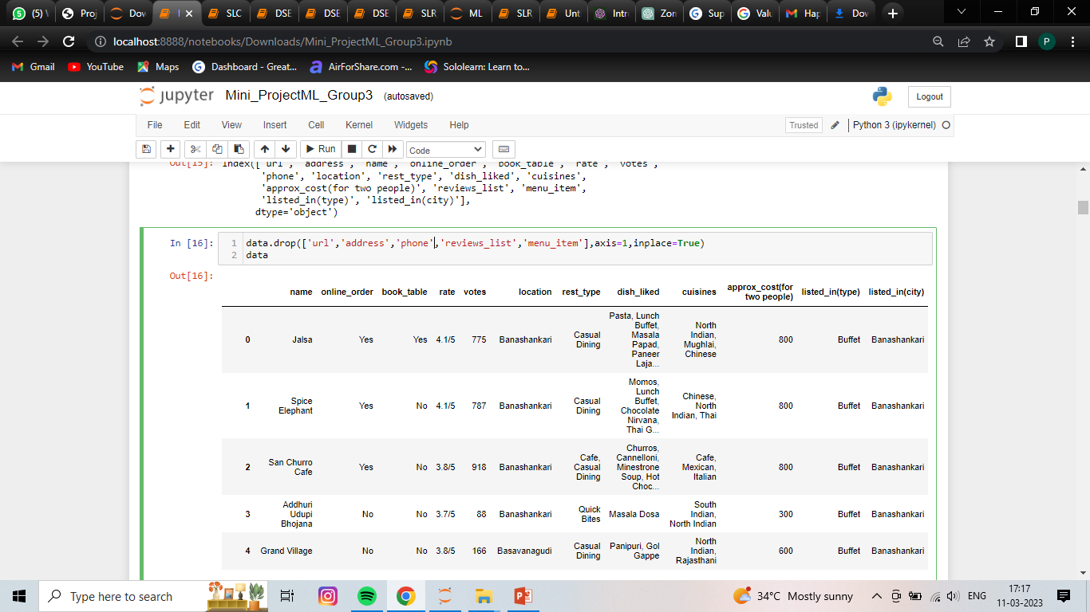
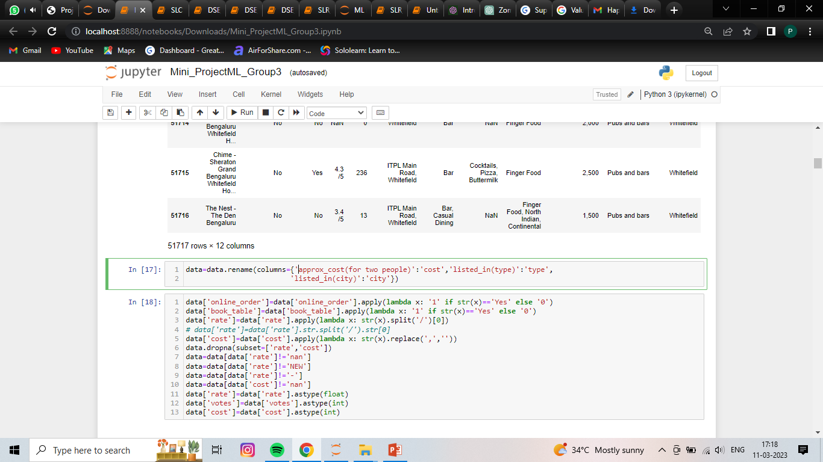

Slide 8
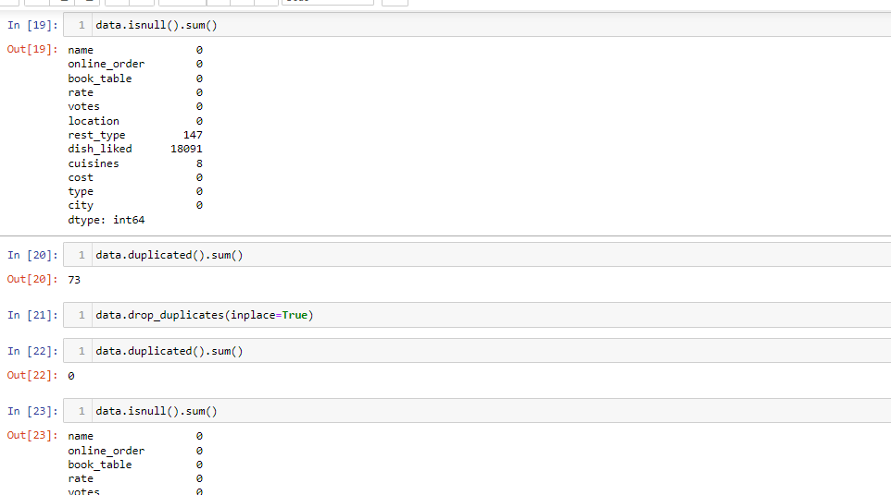
Step 3: Perform the described method for the data, Try to find any essential points from the described analysis. And check the missing values and Duplicate records. Impute the missing values in the best way possible. Note: To impute the missing values with parameters, You must find the best parameter.

Slide 9
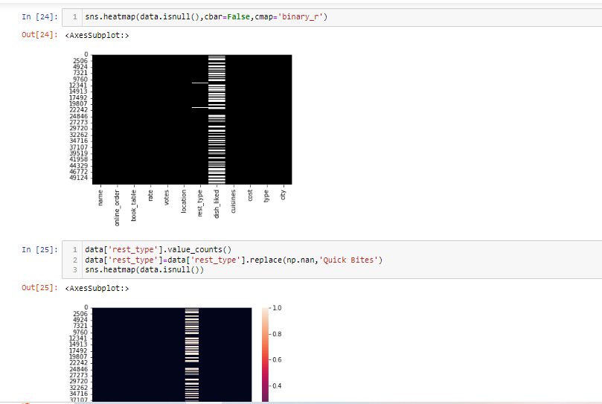

Slide 10
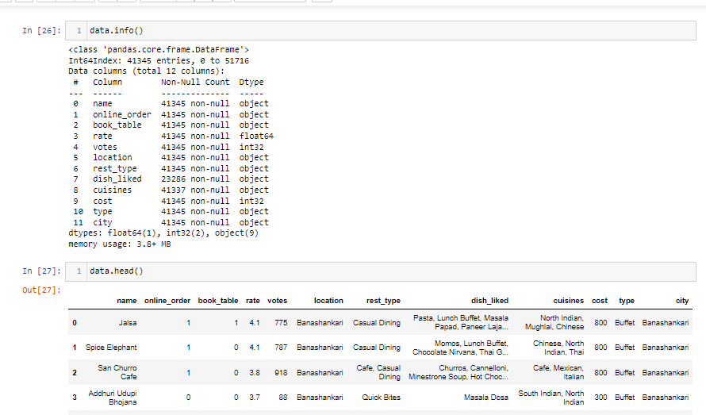

Slide 11
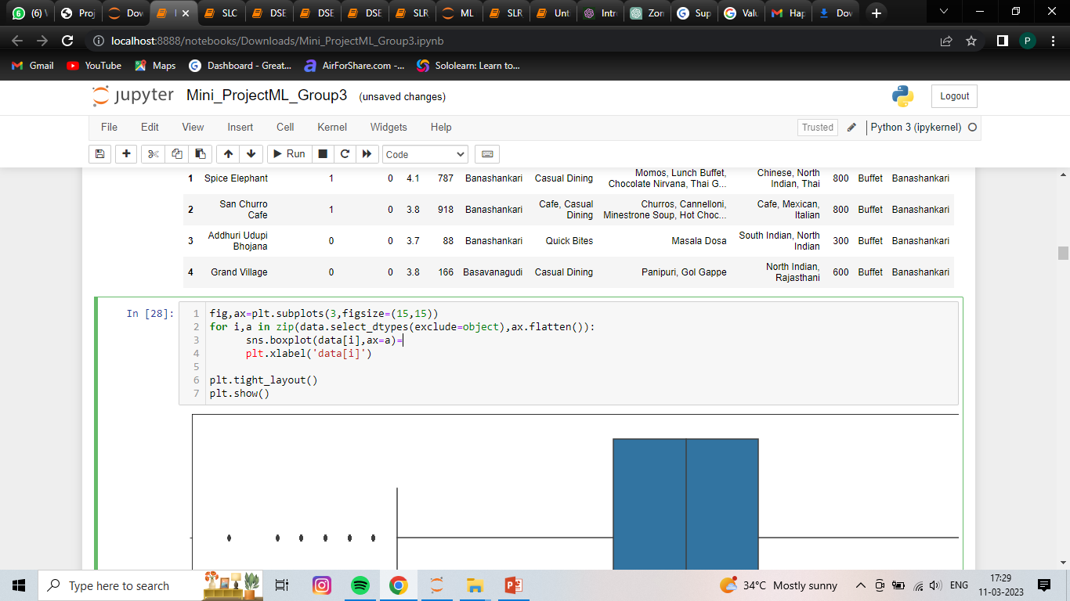
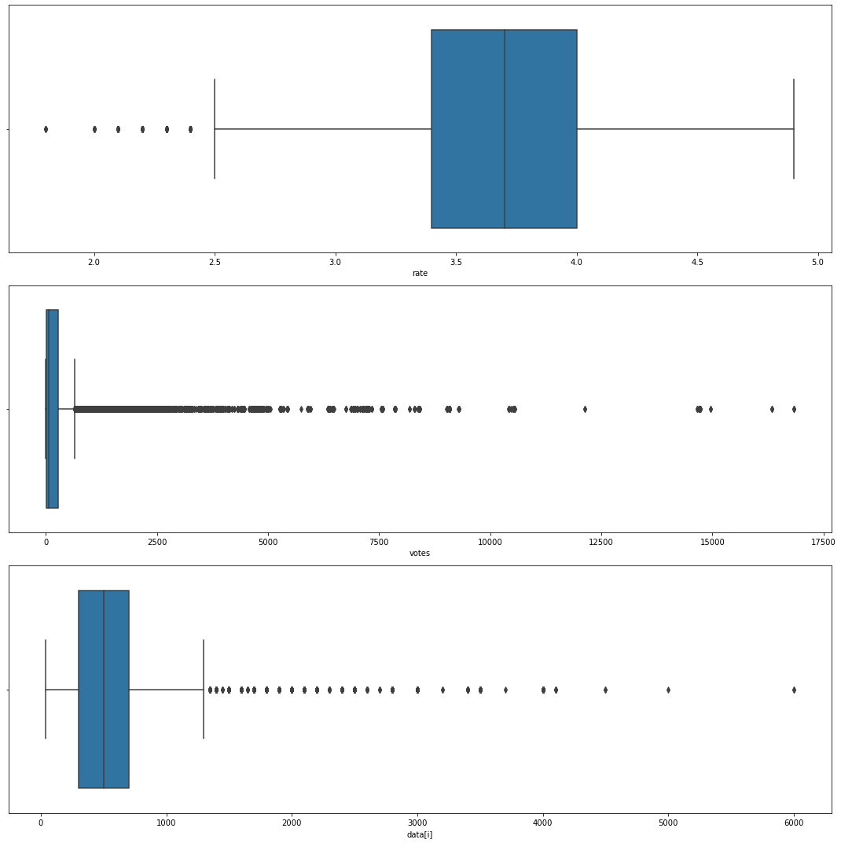

Slide 12
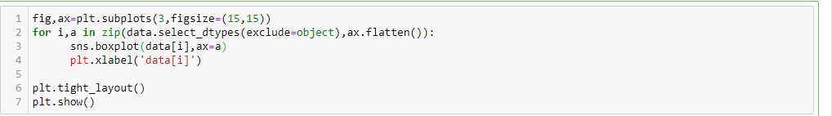

Slide 13
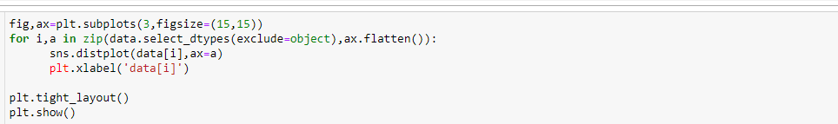
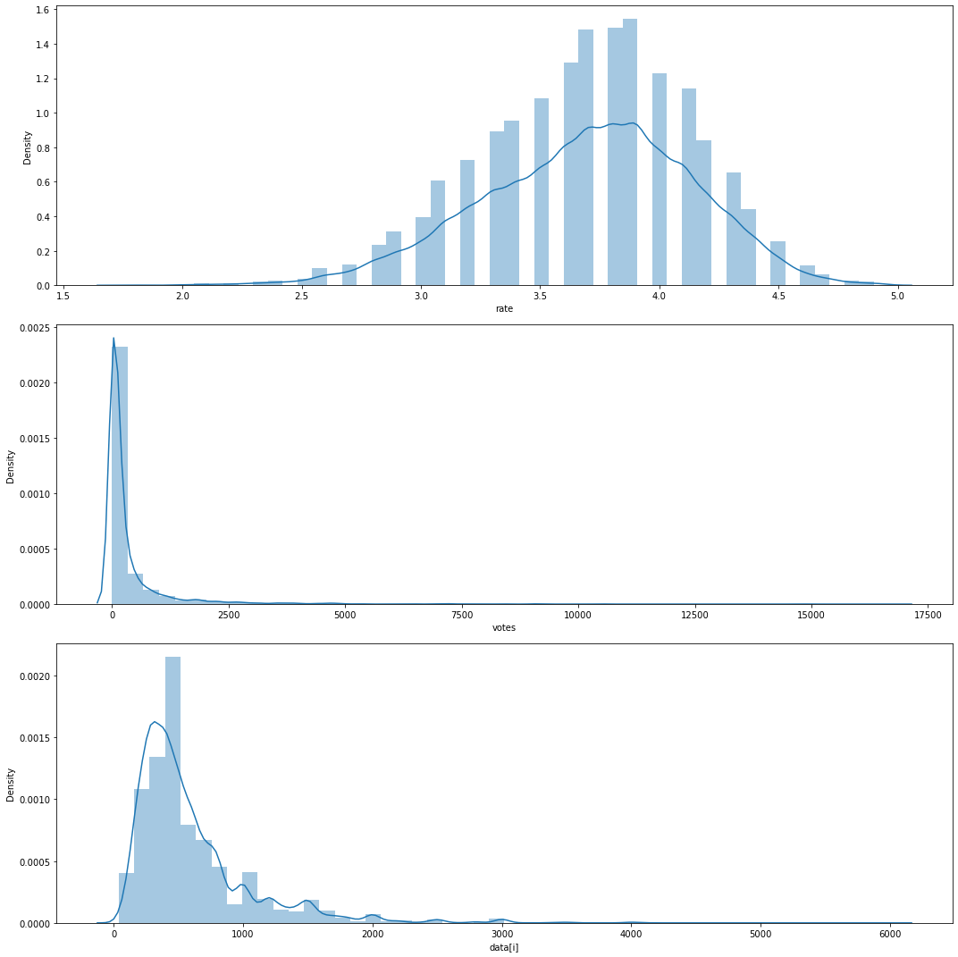

Slide 14
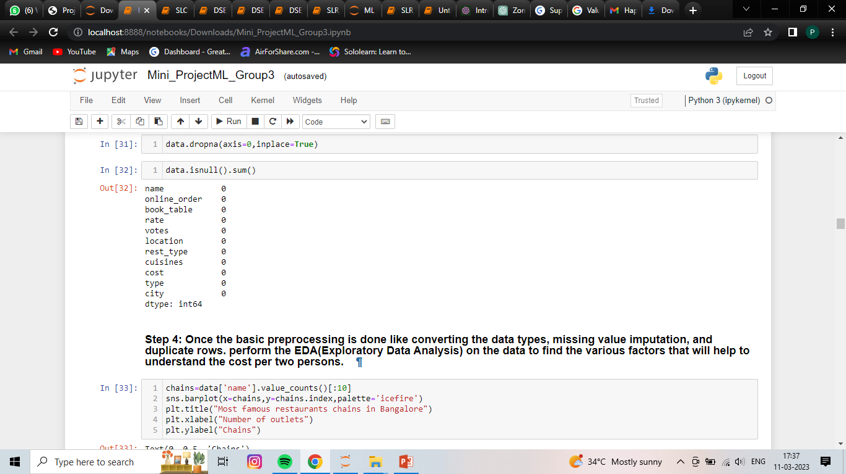
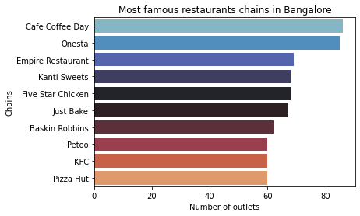

Slide 15
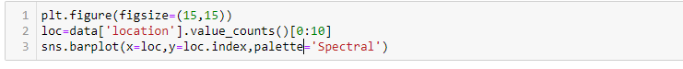
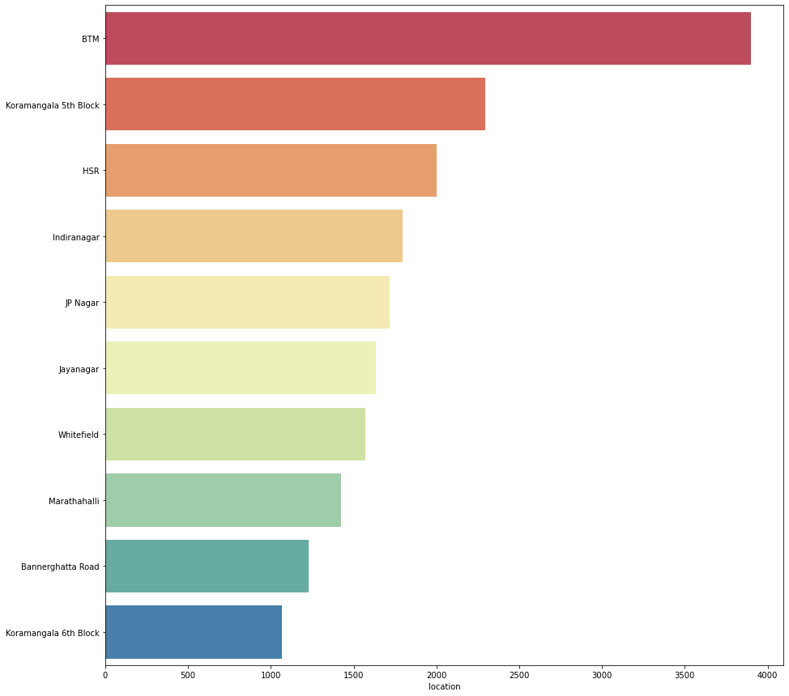

Slide 16
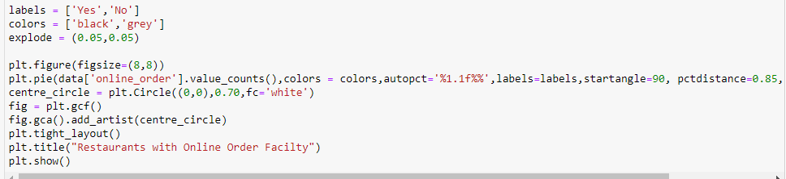
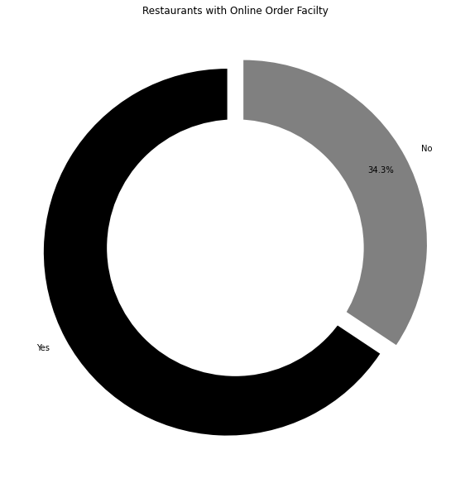

Slide 17
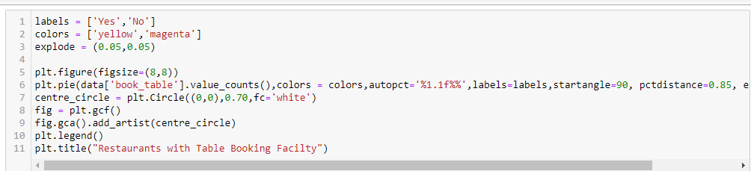
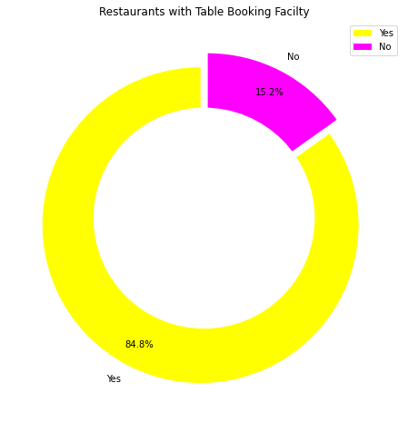

Slide 18
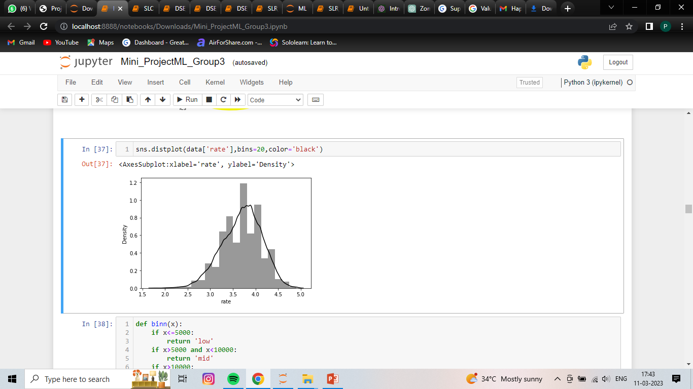
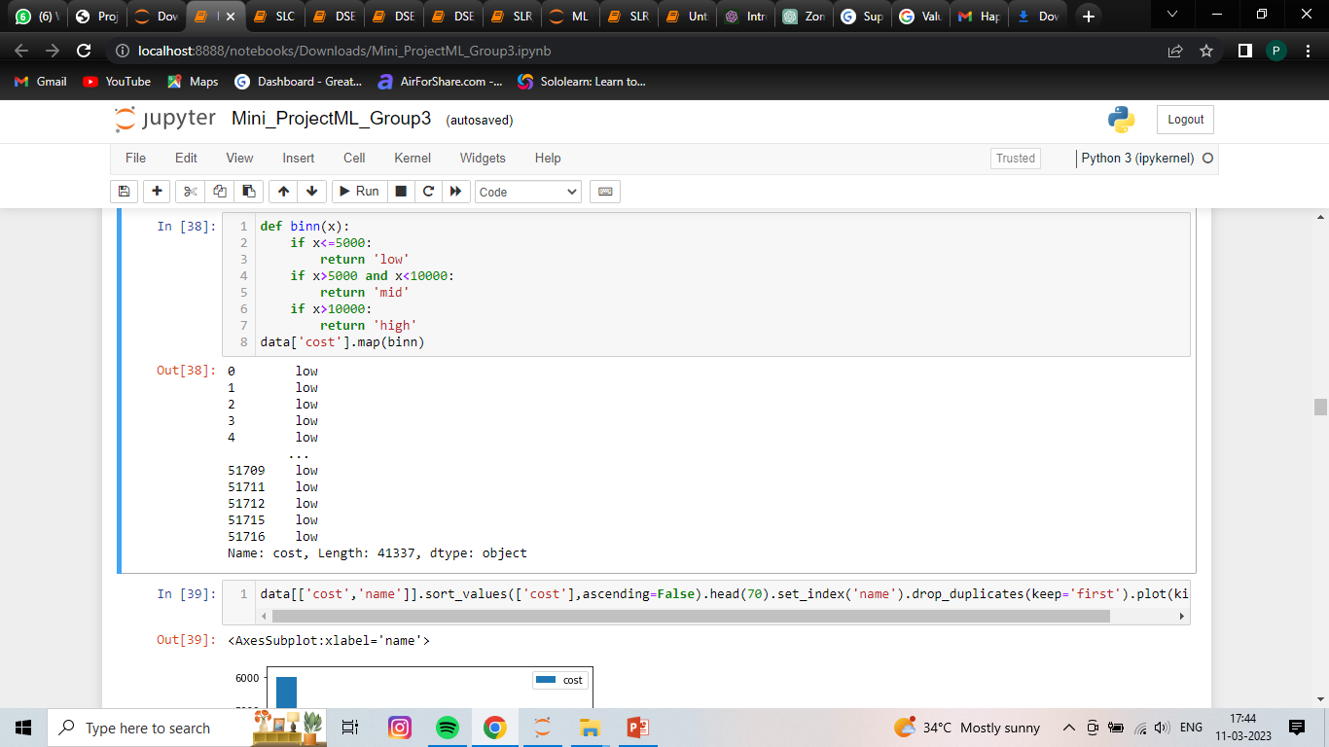

Slide 19
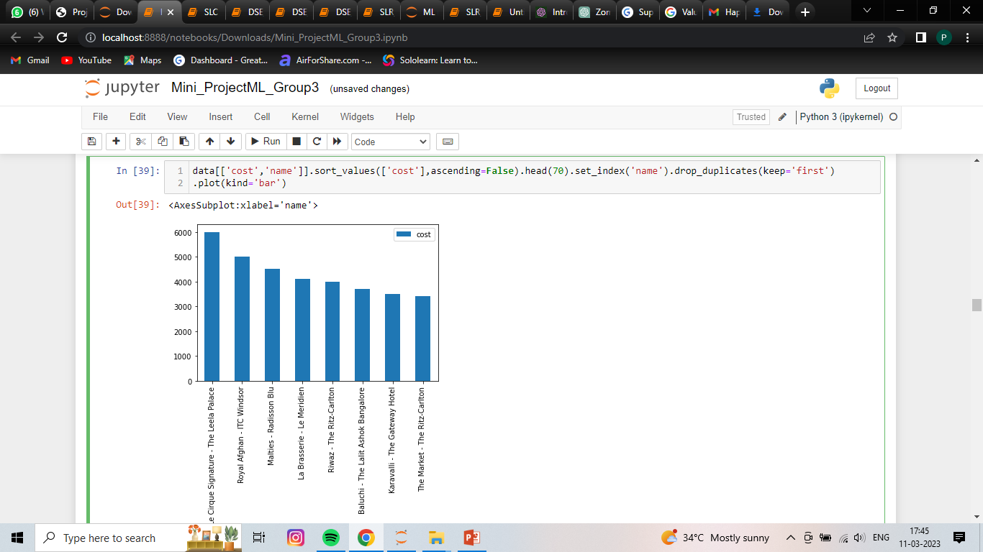
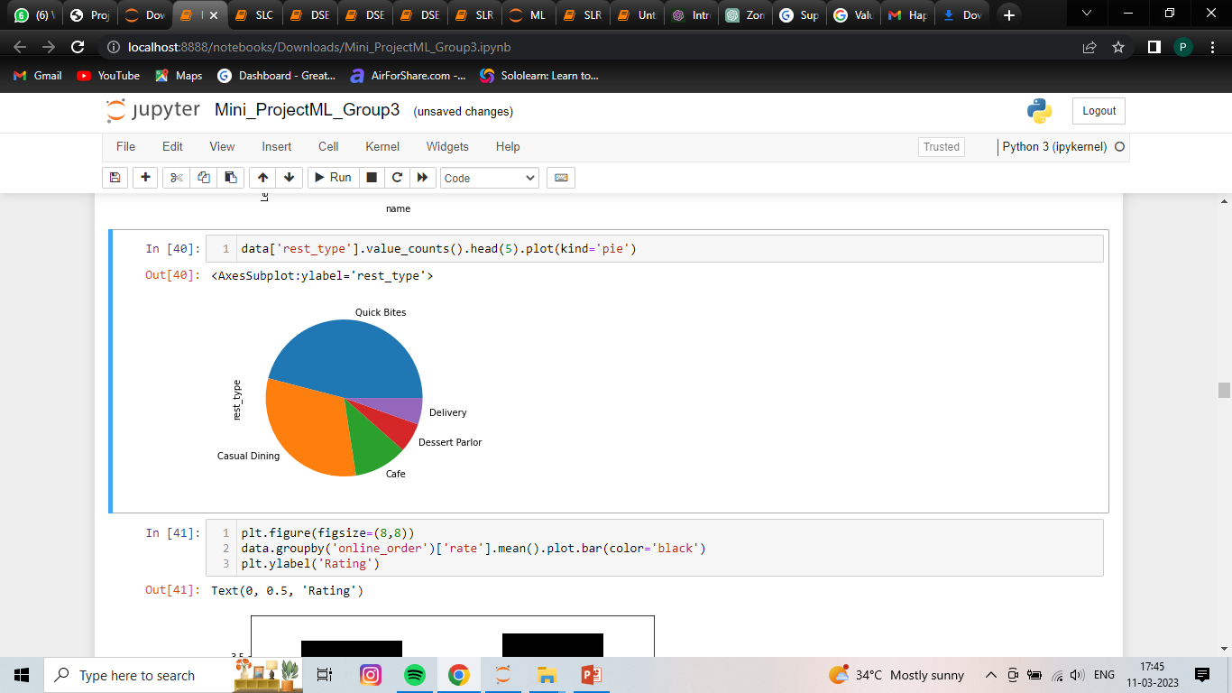

Slide 20
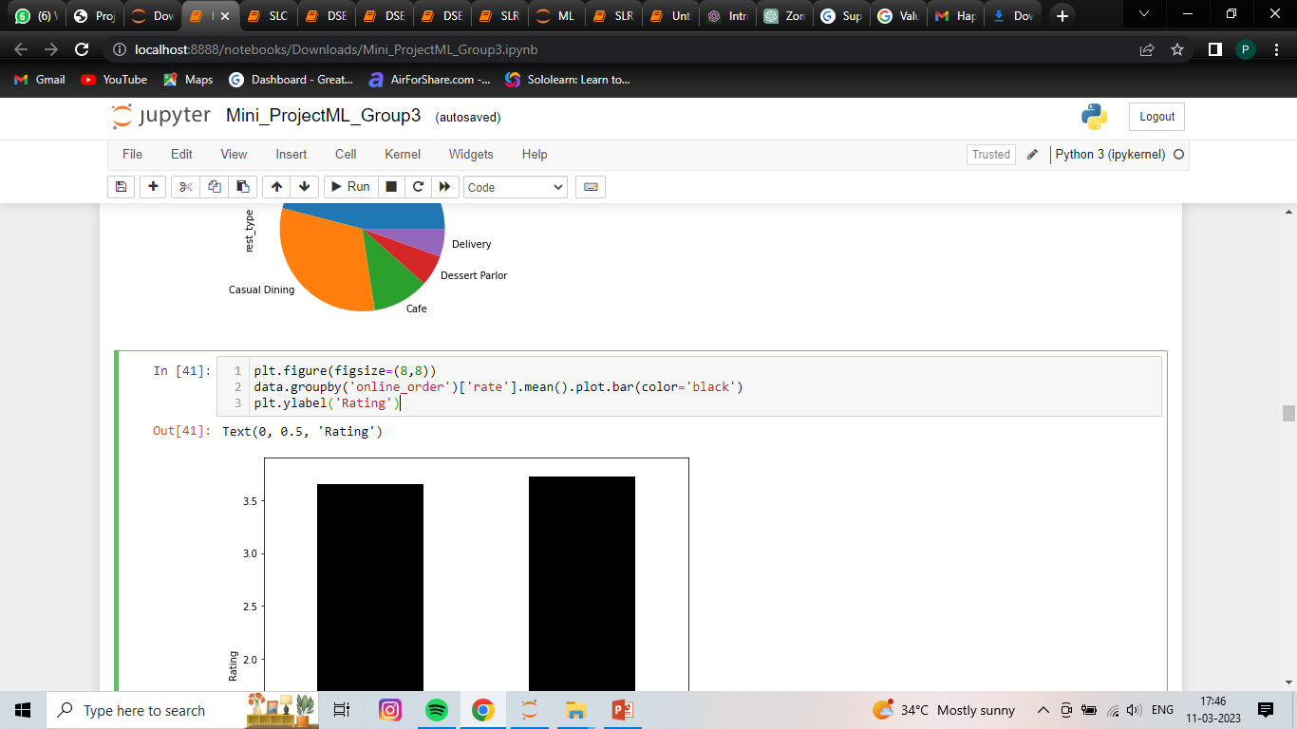
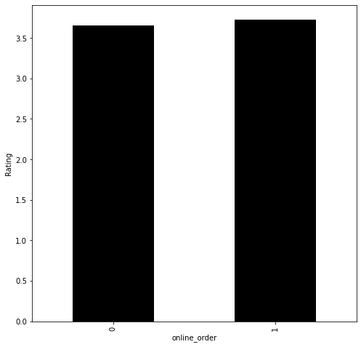
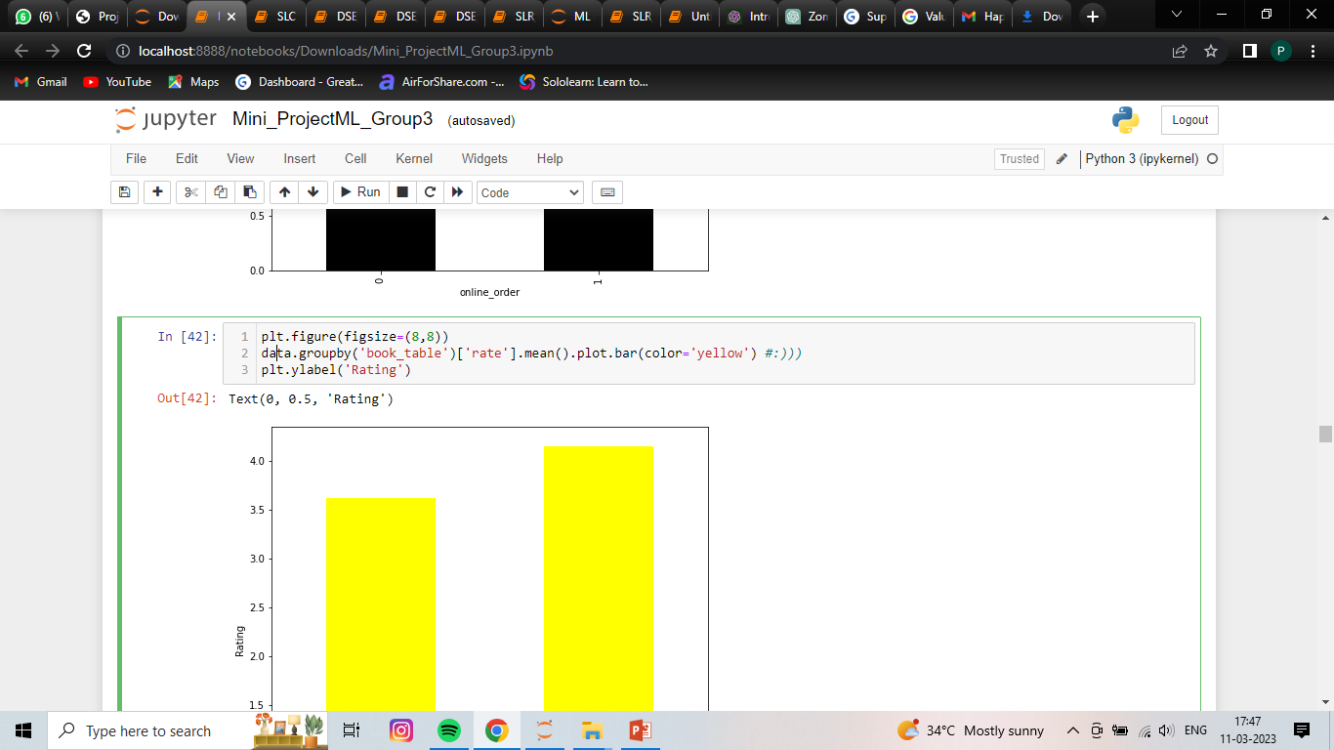
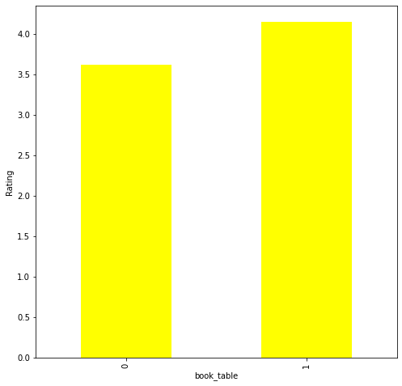

Slide 21
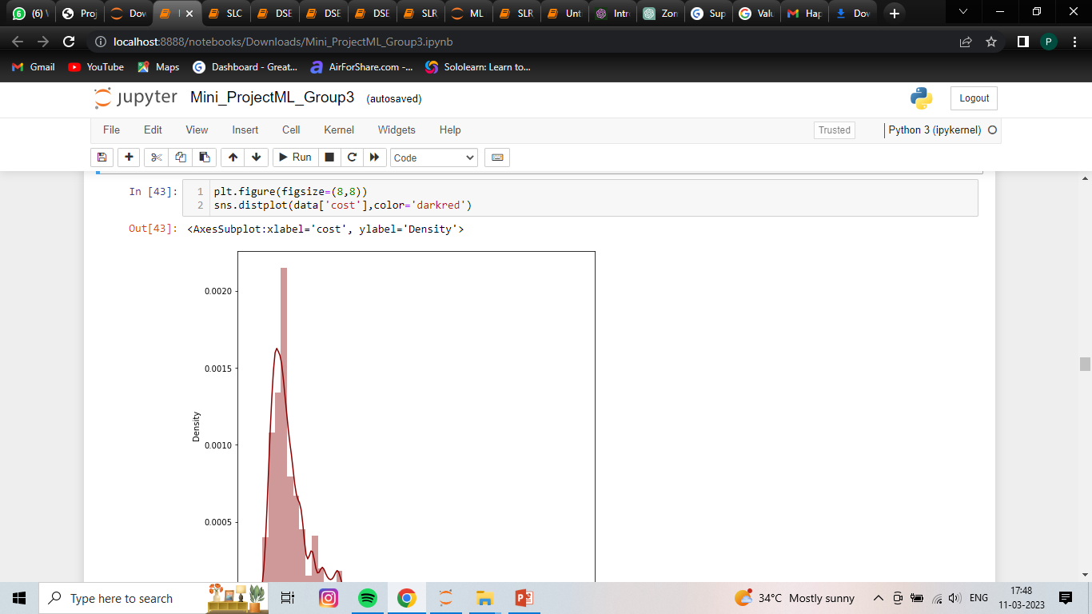
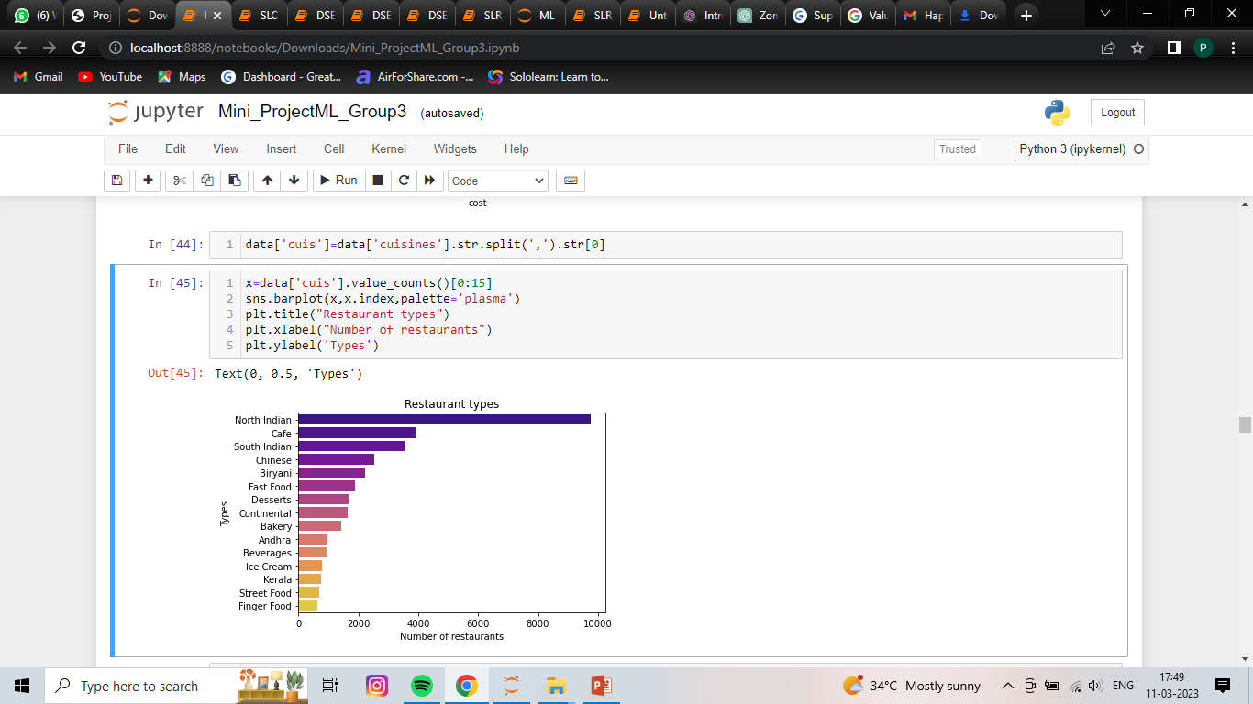
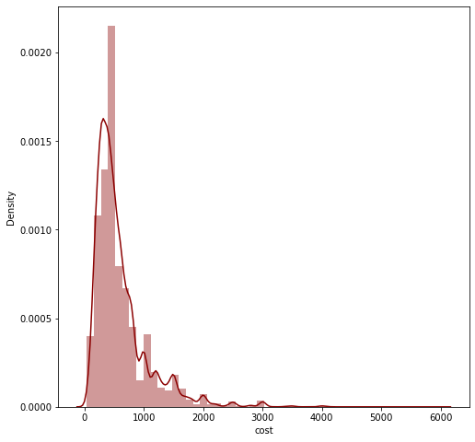

Slide 22
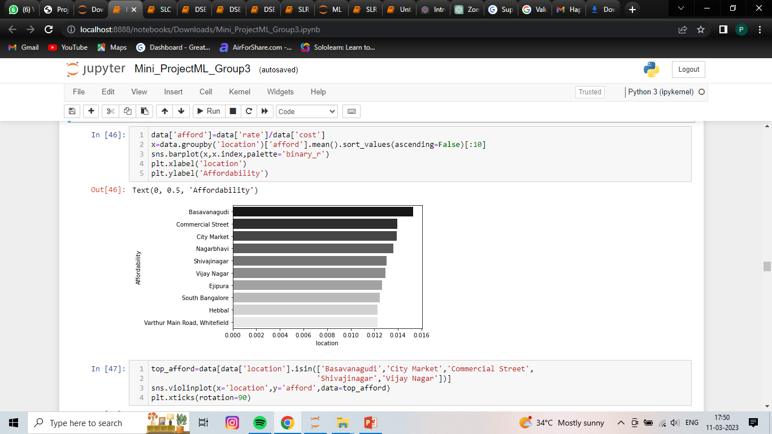
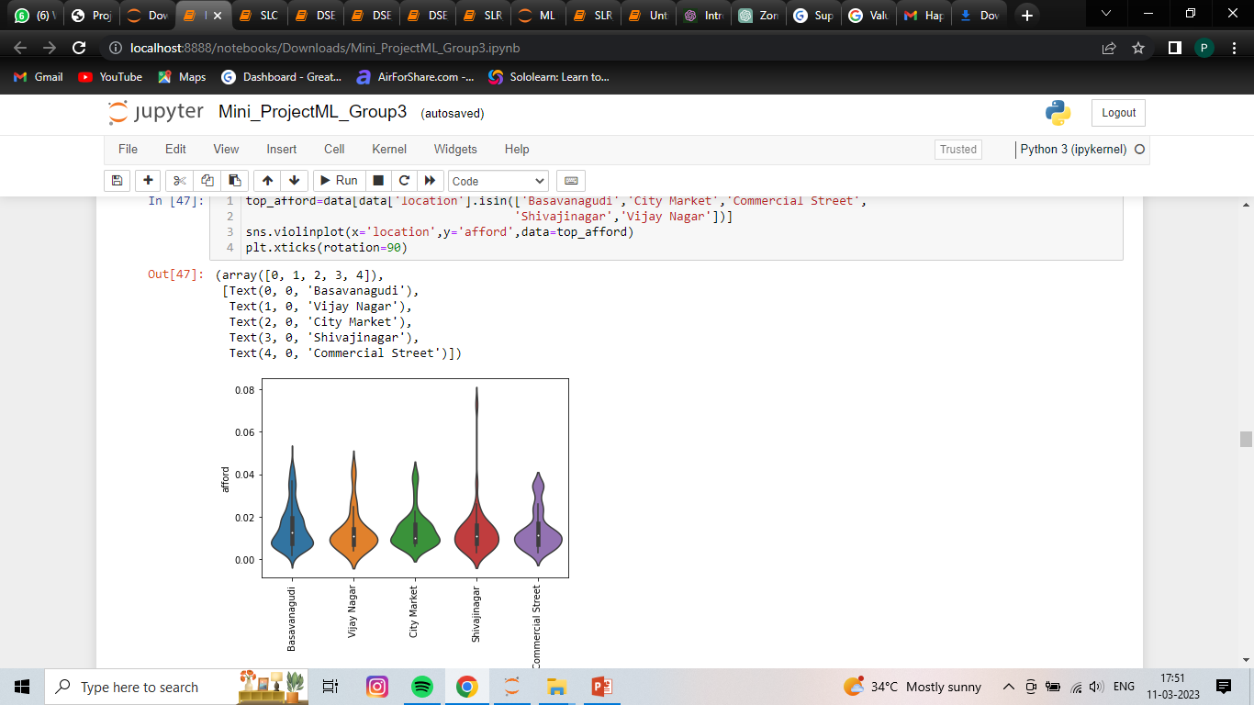

Slide 23
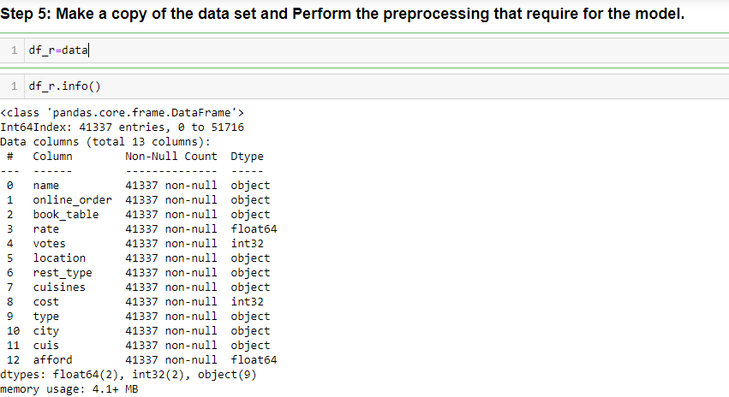

Slide 24
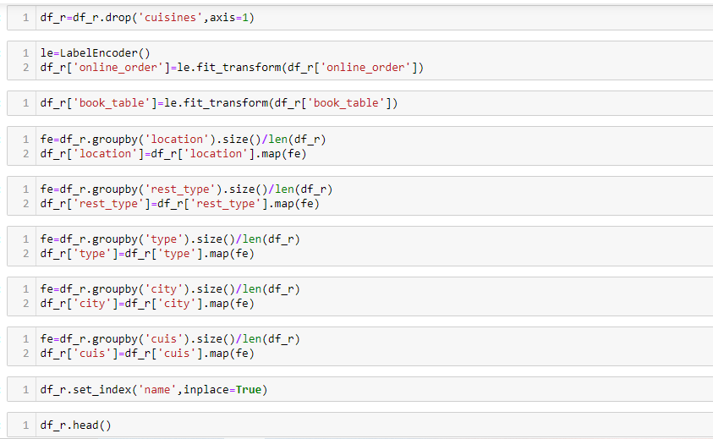

Slide 25
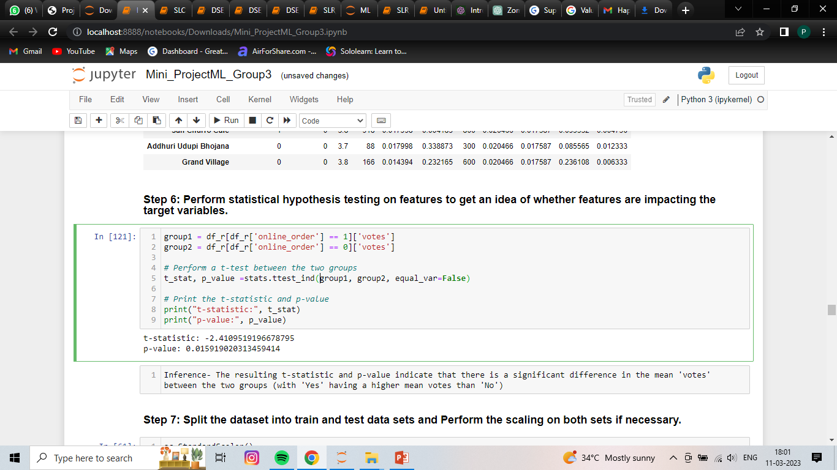
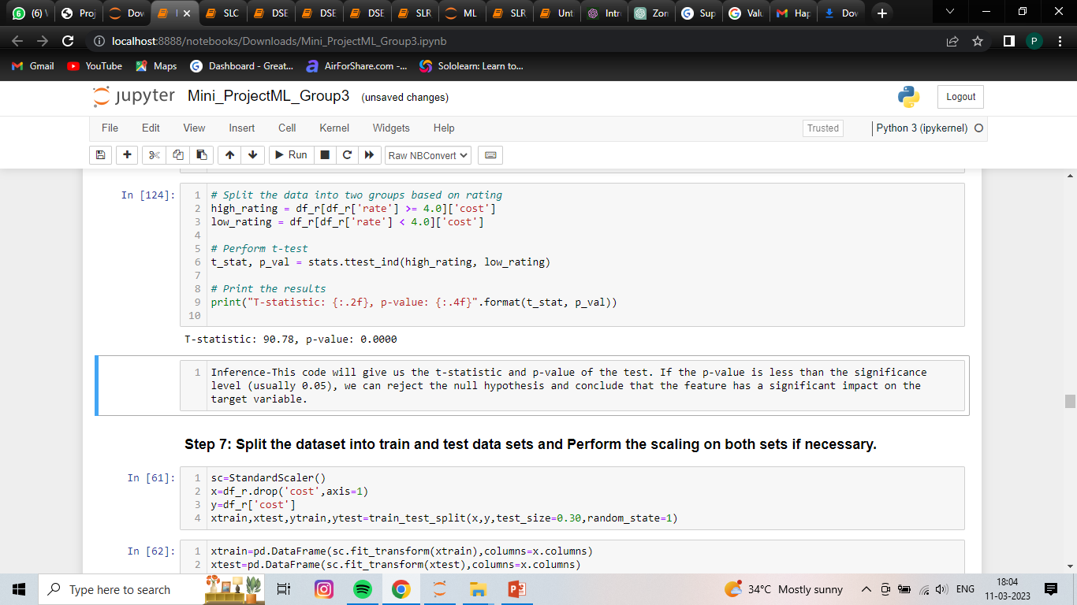

Slide 26
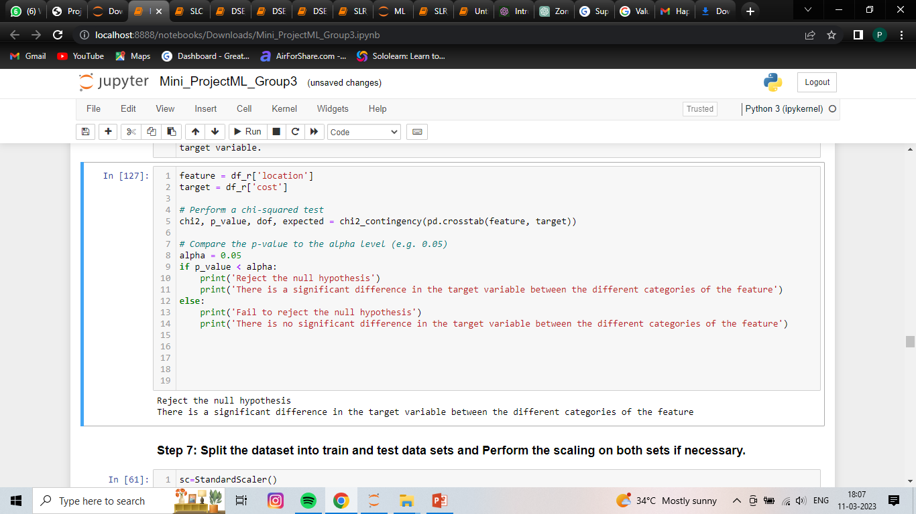
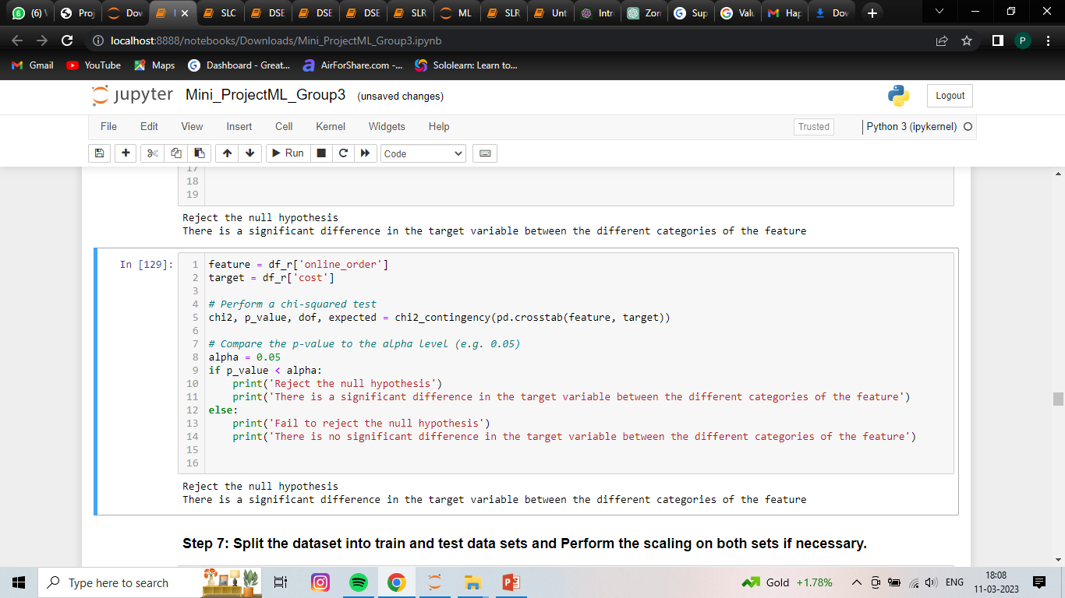

Slide 27
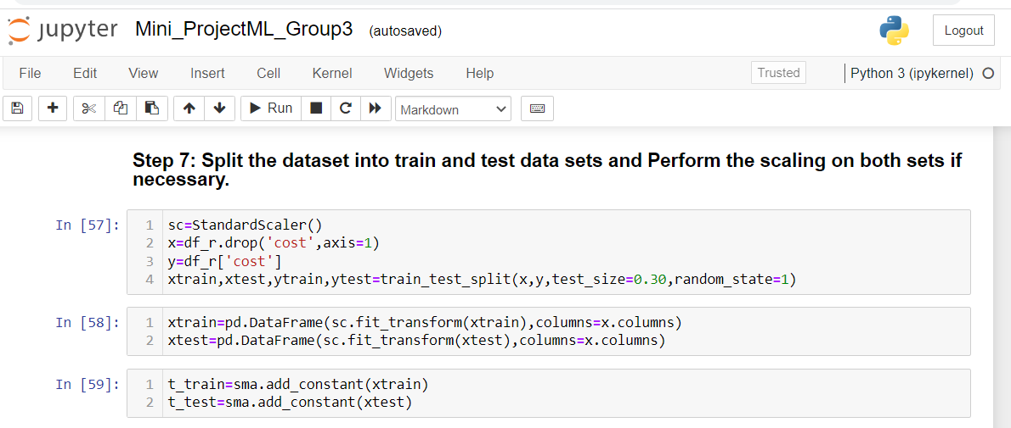

Slide 28
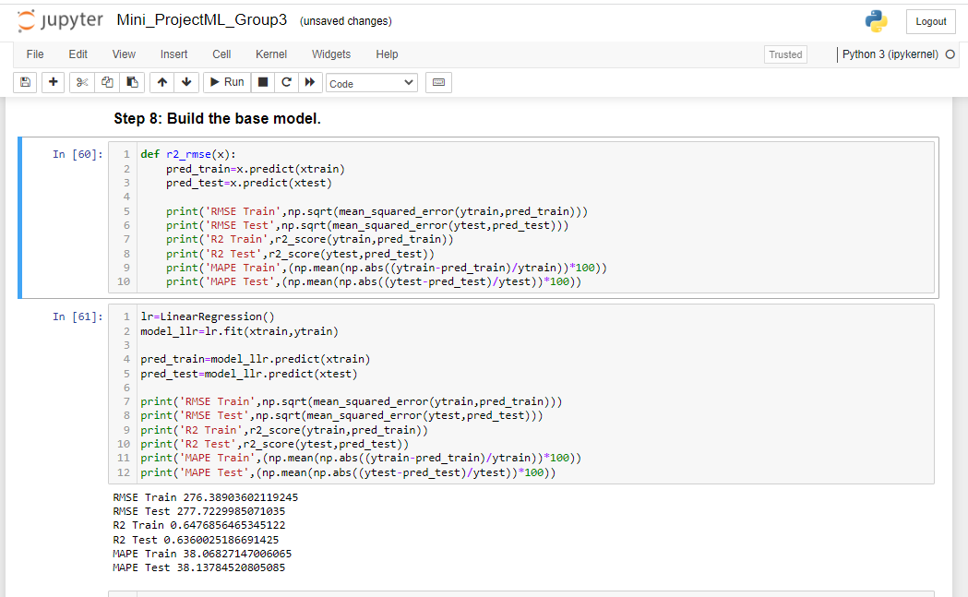

Slide 29
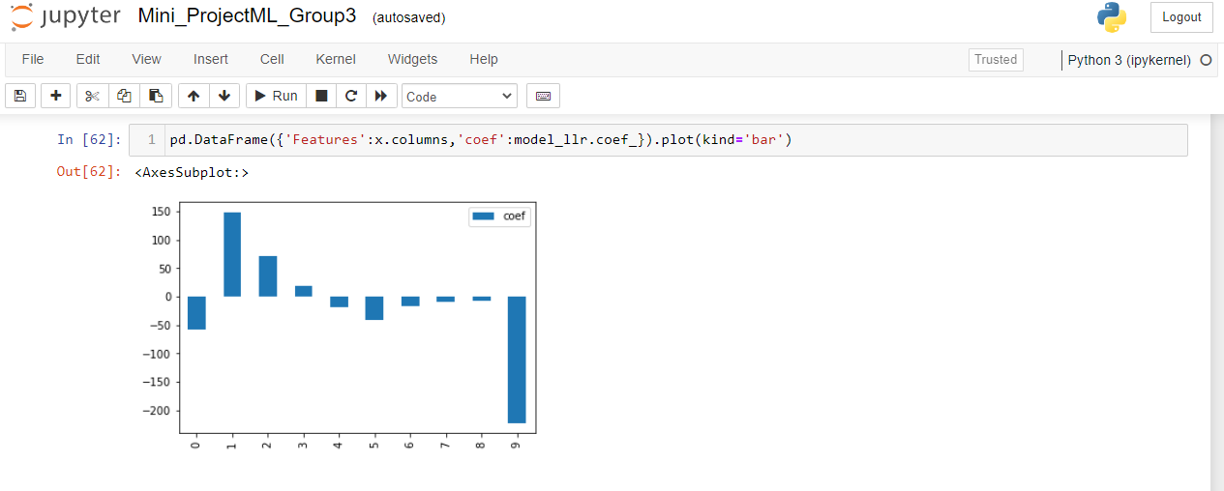

Slide 30
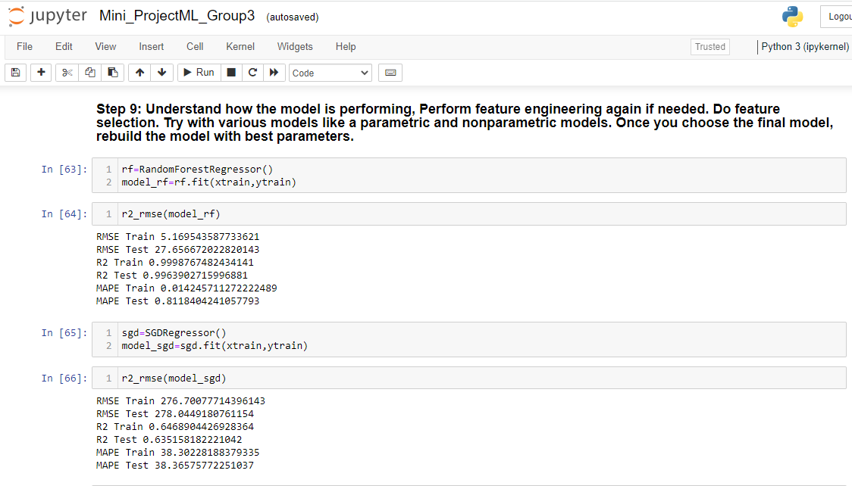

Slide 31
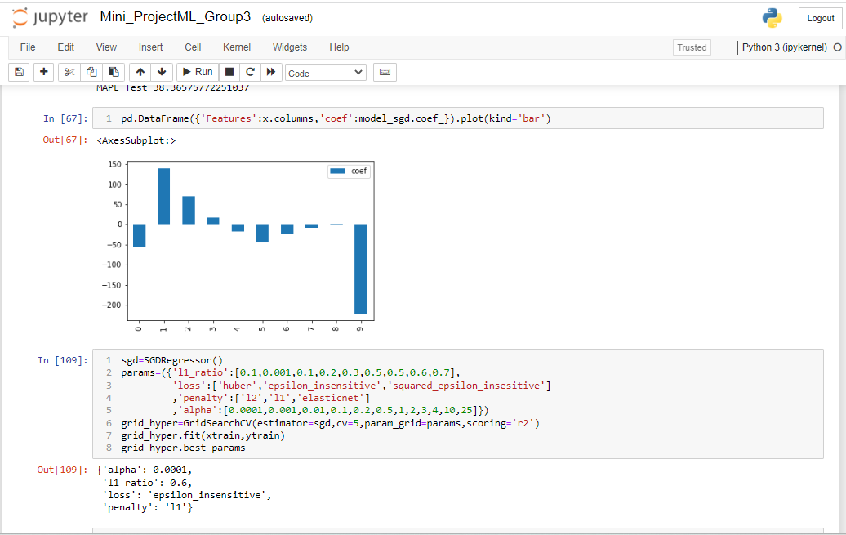

Slide 32
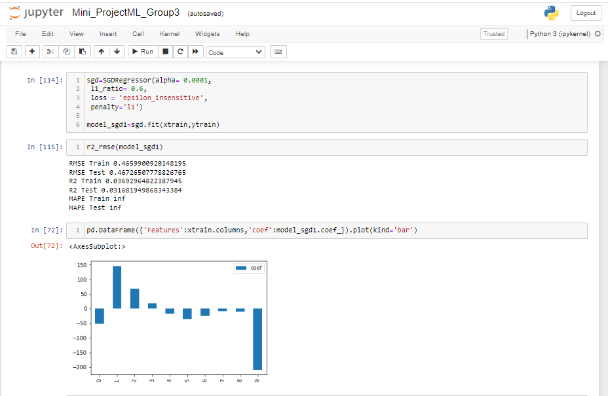

Slide 33
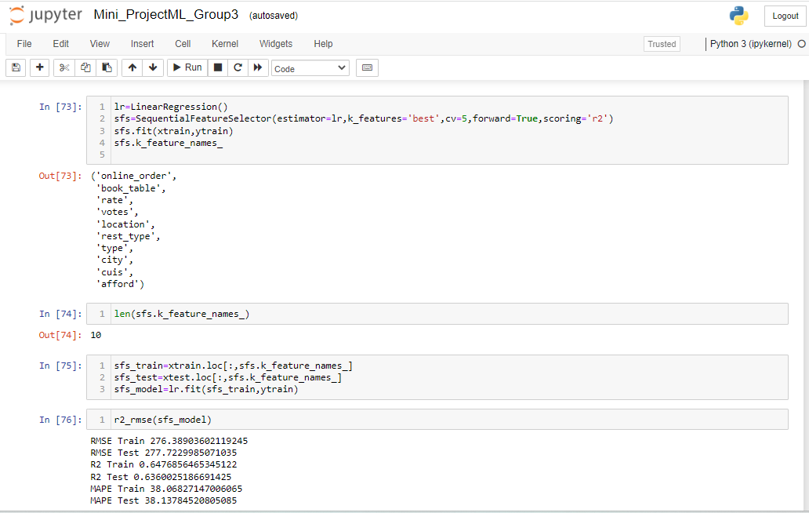

Slide 34
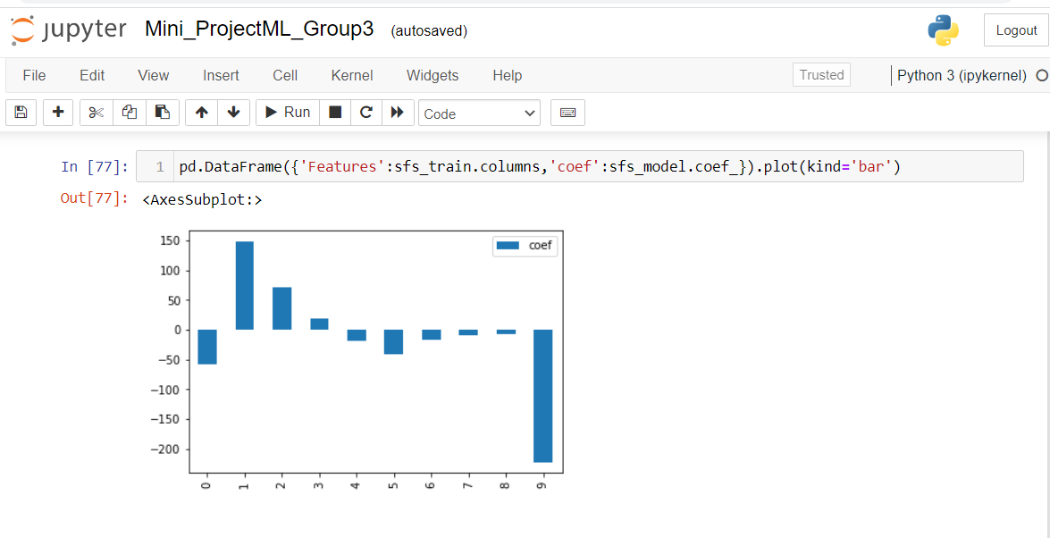

Slide 35
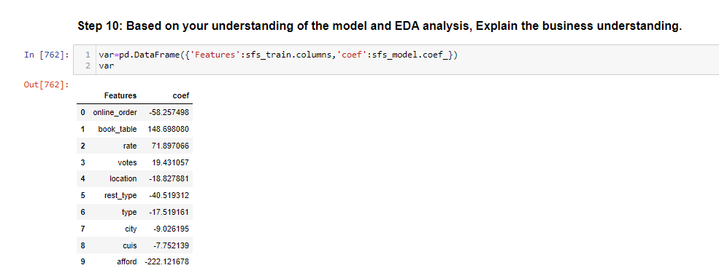

Slide 36
Section B:
Title: Classification Problem Statement:
The model that you built in the above case study has gone to deployment and Zomato has been impressed with your data analysis and Zomato has been believing that your analysis going to be impactful. Now Zomato has been observing the orders happening online and offline, Due to offline orders, Zomato is not able to attract customers with diverse items and offers, and the user subscription also getting low. so it has decided to give you the project on the same. Now the problem statement is that Zomato wants to know whether the customer would order the orders online or offline so that Zomato can take further strategies to improve the online order.
Objective: The Aim is to classify the orders that have been ordered online and offline. And identify the patterns that lead to orders online orders as well as offline. Your model should be able to classify the classes effectively

Slide 37
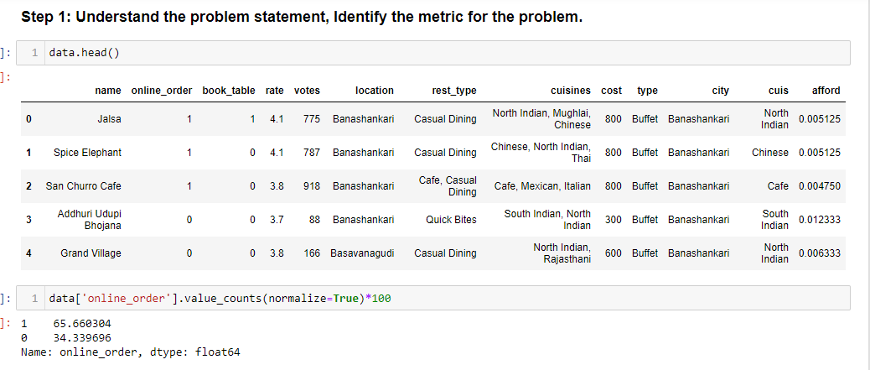

Slide 38
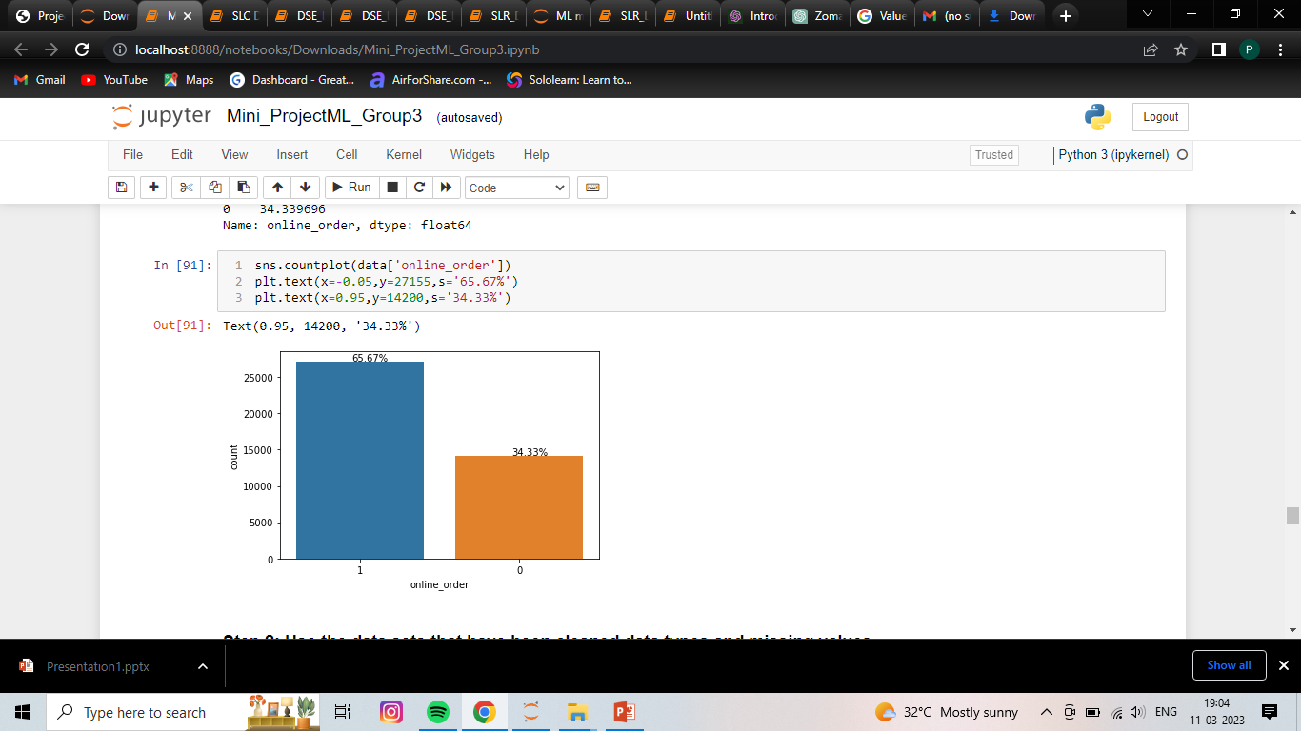


Slide 39



Slide 40



Slide 41



Slide 42



Slide 43



Slide 44



Slide 45


Slide 46


Slide 47


Slide 48


Slide 49



Slide 50


Slide 51



Slide 52



Slide 53


Slide 54



Slide 55



Slide 56


Slide 57


Slide 58



Slide 59


Slide 60


Slide 61
Conclusion:
Based on the available information, it appears that Zomato is facing challenges with its offline orders, which is impacting its ability to attract customers with diverse items and offers. Additionally, the user subscription is also decreasing, indicating a need for further strategies to improve the online order process.
To address this problem, Zomato can consider the following strategies:
Offer incentives for customers to order online - Zomato can offer discounts or cashback offers for customers who place their orders online, which could encourage them to switch from offline to online orders.

Slide 62
Thank You

